Slide 1
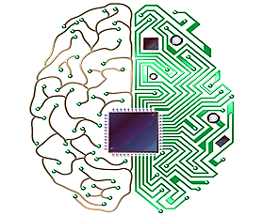
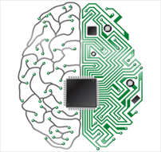
Cognitive Computing and It’s Applications
Sai Kumar Dandla
IBM certified DS Professional | Google Certified Tensor flow Developer
AI Researcher, DRDO Young Scientist Lab-Cognitive Technologies

Slide 2
Agenda
Introduction
New era of cognitive computing
Definition and characteristics of cognitive computing
Top Challenges to Adoption of Cognitive Computing
Cognitive Computing - Trends
Cognitive Engineering Systems
Reference
1
Cognitive Computing and It’s Applications

Slide 3
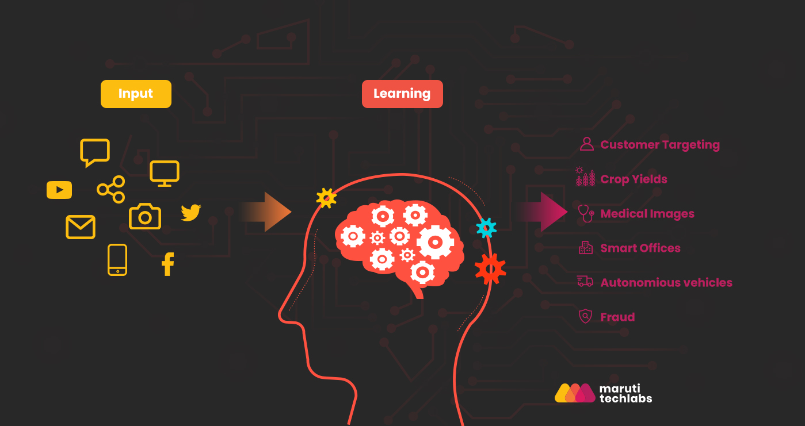
Introduction
The goal of cognitive computing is to create automated IT systems that are capable of solving problems without requiring human assistance
The Cognitive is the mental action to learning and acquiring through thought, experience, and the senses .
Cognitive computing involves the systems that can analyze , memorize ,processing to mimic the way the human brain works.
Cognitive Computing and It’s Applications

Slide 4
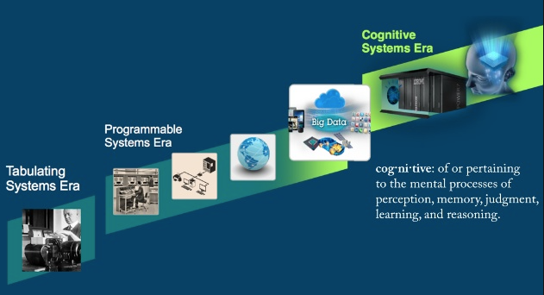
New Era of Cognitive Computing
Cognitive technology is different; it accelerates, enhances and scales human expertise to solve more complex problems by understanding language and interacting more naturally with humans. It can reason to find patterns and form hypotheses, making considered arguments and scenarios planning. A good example of a cognitive computing system is IBM’s Watson
Cognitive Computing and It’s Applications

Slide 5
Definition of cognitive computing
‘’Cognitive computing is quickly emerging as a transformative technology that enables organizations to gain business advantage. This shift to systems that can reason and learn is especially germane to the bottom line; the cognitive era is here in large part because it makes practical business sense.” - IBM
The basic idea behind this type of computing is that to develop the computer systems (include hardware and software) who interacts with human like humans.
These computer can recognize ,understand ,analyze and take out the best possible result as or near about the human brain.
Cognitive Computing and It’s Applications

Slide 6
Characteristics of cognitive computing
The major characteristics of cognitive computing systems:
Information adept
Dynamic training and adaptive
Probabilistic
Highly integrated
Meaning based performance
Highly interactive
Cognitive Computing and It’s Applications

Slide 7
Top Challenges to Adoption of Cognitive Computing
Implementation effort / cost. In some cases, the effort and cost to implement AI technologies can be high. Enterprises want to understand the business value and ROI. Limited case studies exist for cognitive computing, creating potential hurdles to large-scale investment.
Data management and security / privacy Concerns. . Cognitive systems will rely heavily on data derived from multiple systems and sources. As such, it is important to ensure data is consolidated and sourced in a consistent, secure manner. Safeguards are needed against data overreach and abuse of privacy.
Insufficient Skills. AI technologies and cognitive computing solutions are emerging at a fast pace. Like any emerging tech area, there is limited skills in the marketplace.
Lack of industry definitions and standards. Similar to other emerging areas, the lack of industry standards and definitions around artificial intelligence and cognitive solutions may create hesitation in adoption.
Limitations of current technology. While there are important reasons to move forward with cognitive technology, firms must consider the constraints of existing platforms relative to their ultimate goals.
Cognitive Computing and It’s Applications

Slide 8
Cognitive Computing – Trend
Drivers
Advances in enabling AI technology areas
Increasingly large complex datasets that can be the source of major insights and hold the answers to critical questions
Third computing platform – Cloud, IoT, Mobile, Big Data, Analytics, Social
Challenges
Much more work on enabling technologies required
Documented use cases and ROI impact not yet fully understood
Education future of AI’s impact on jobs and society
Window of opportunity: Partnerships / Ecosystems / Developers
Implications
First movers will have an advantage.
This is a technology that learns. Accuracy will increase over time.
Cognitive services will be delivered via the cloud to mobile device
Expect the mass market to develop around consumers at a fast pace.
Business processes and whole industries will be transformed.
Changes will be required in employee workforce, corporate culture, and partner ecosystems.
New IT architectures, systems design, data management/analytics and workload optimized systems.
Job displacement will happen, but new jobs will be created. Scenario planning needed to understand long term implications.
Cognitive Computing and It’s Applications

Slide 9
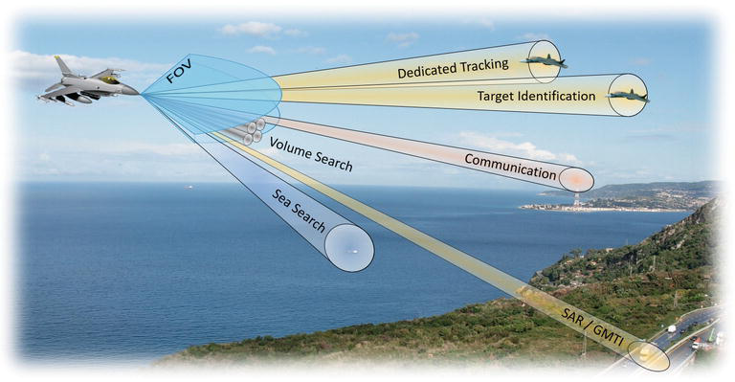
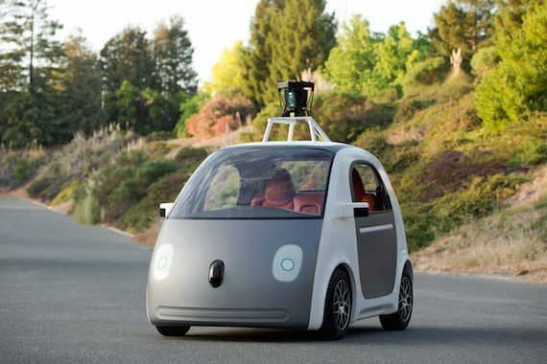
Cognitive Engineering Systems
Cognitive Radar
Cognitive radars are systems based on the perception-action cycle of cognition that sense the environment, learn from it relevant information about the target and the background, then adapt the radar sensor to optimally satisfy the needs of their mission according to a desired goal.
Cognitive Consequence of Self-Driving Cars
Cognitive self driving car is an intriguing use case that requires intelligence beyond the state of the art in machine learning, computer vision, and AI. Current state-of-the-art approaches to both intelligent perception and decision making typically rely on machine learning with offline training of neural networks using elaborated datasets.
To enable truly adaptive intelligence, as we know it from biological systems, learning that supports decision making and perception needs to happen in real time, in an online fashion.
Cognitive Computing and It’s Applications

Slide 10
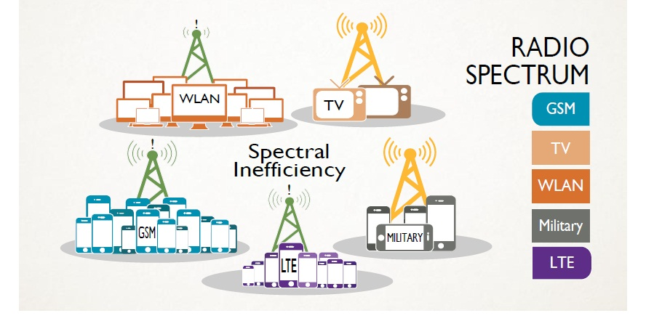
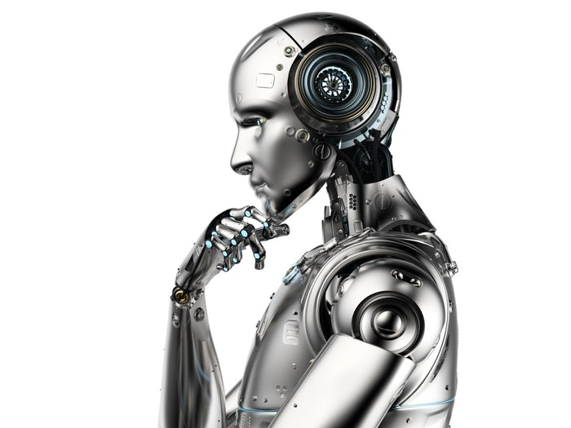
Cognitive Engineering Systems
Cognitive Radio
Cognitive Radio is a concept introduced to attack the upcoming spectrum crunch issue. Cognitive Radio users are unlicensed users who find unused licensed spectrum dynamically for its own use without causing any interference to licensed users.
Cognitive Robotics
Cognitive Robotics is an emerging field of robotics , which will continue to evolve for the years to come. The field of cognitive robotics generally comprises the design and use of robots with human-like intelligence in perception, motor control and high-level cognition. To realize cognitive robots many overlapping disciplines are needed, e. g. robotics, artificial intelligence, cognitive science, neuroscience, biology, philosophy, psychology, and cybernetics.
Cognitive Computing and It’s Applications

Slide 11
Reference
1. Cognitive Computing: A new era - IBM
Dr. John E. Kelly III. Senior Vice President,. Cognitive Solutions and IBM Research. UBS AI
2. Potential of Cognitive Computing and Cognitive Systems
Ahmed K. Noor, Old Dominion University
3. AI / Cognitive Computing Trend Report, 2017
Andrew Onda, Manager – Cognitive Solutions, Market Development & Insights
4. Kelly J. E., Hamm S., Smart machines: IBM’s Watson and the era of cognitive computing,
Columbia University Press, New York, 2013,
Cognitive Computing and It’s Applications

